Slide 1
Fully Convolutional Networks

Slide 2
Contents
Preliminaries
Development Pipeline for Learning-based Approaches
Tasks in visual recognition
Practice - Implement Fully Convolutional Network with PASCAL VOC
Environment setting
Exercise 1. Implement bilinear interpolation with deconvolution
Exercise 2. Classification network into fully-convolutional network
Exercise 3. Optimization procedure
Exercise 4. Construct confusion matrix and compute meanIU

Slide 3
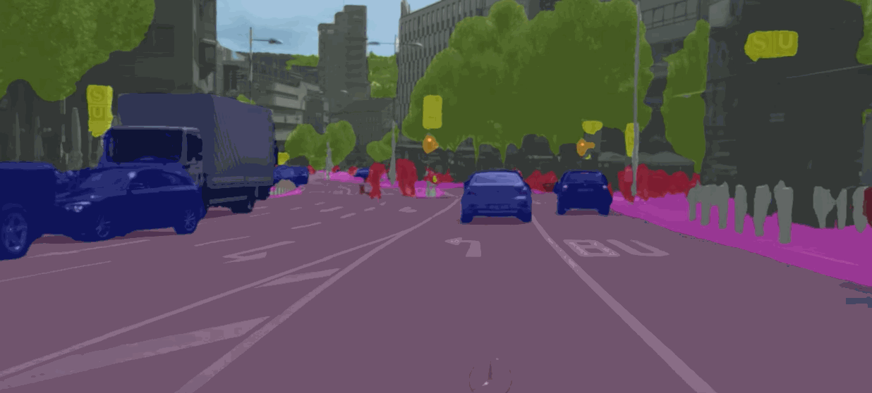
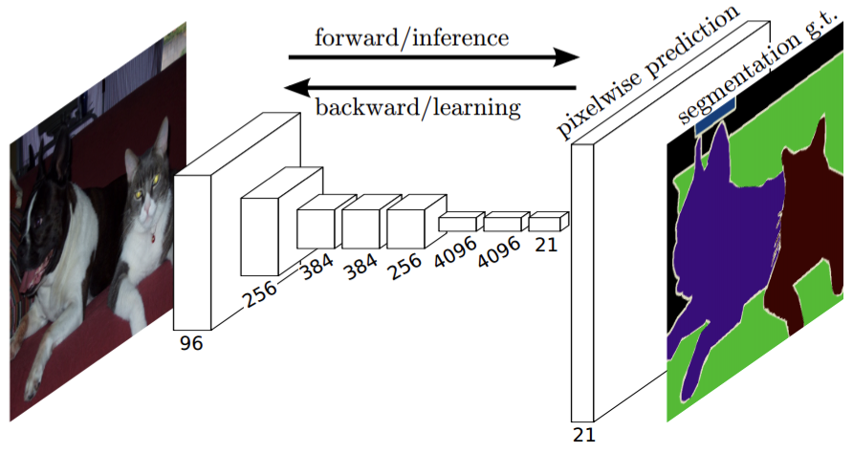
Development Pipeline for Learning-based Approaches
Dataset
Model
(Tutorial 1 & 2)
(Real-world) problem
Learning
Model evaluation
Deployment
Notes:
학습을 사용하여 어떤 알고리즘을 만들자고 하면 이러한 파이프라인을 따른다고 볼 수 있을 것 같습니다. 강의에서는 주로 Model & Learning 부분을 다룬다고 보시면 될 것 같습니다.
이 그림

Slide 4
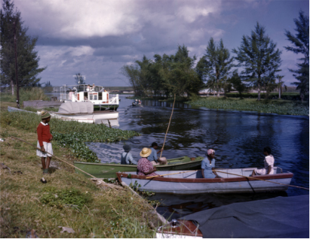
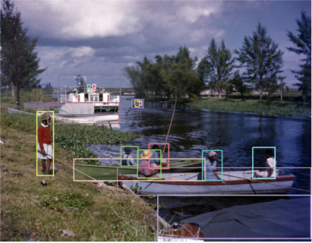
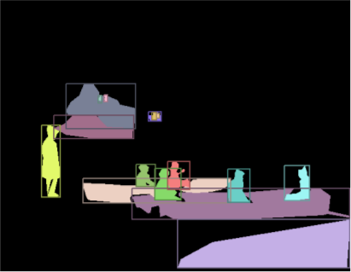
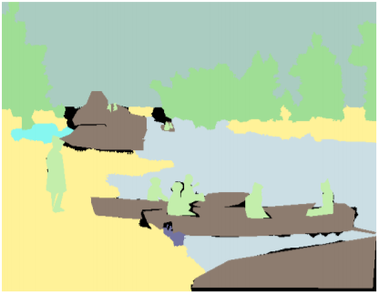
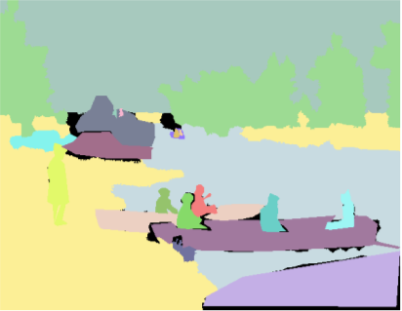
Tasks in visual recognition
boat
human
input image
image classification
object detection
instance segmentation
semantic segmentation
panoptic segmentation
discover the region and class of single object, instance
Each pixel is classified into
predefined scene or object class
Each pixel is classified into
object index/class, scene class
images are captured from the slide (http://presentations.cocodataset.org/COCO17-Invited-PanopticAlexKirillov.pdf) presented at ICCV17 COCO workshop

Slide 5


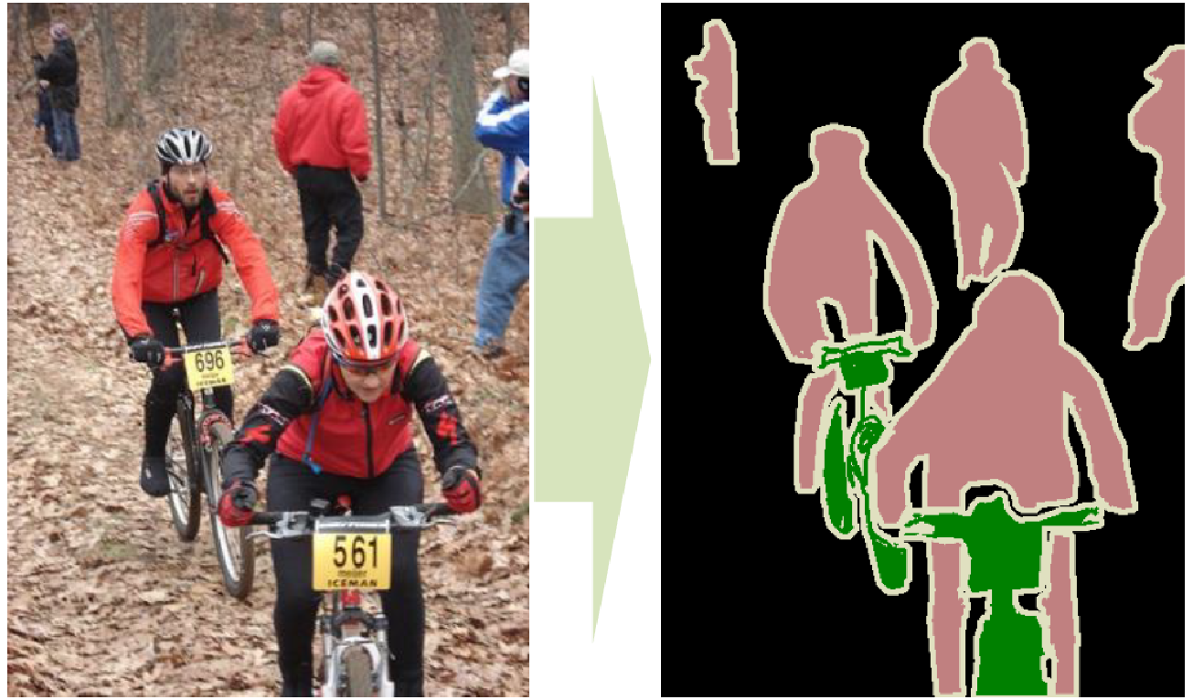
Semantic Segmentation

Slide 6
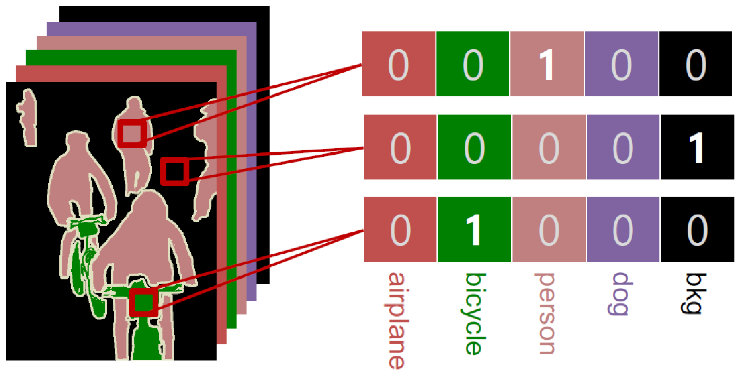
Pixel-wise Classification

Slide 7
Fully Convolutional Networks
Contributions
Implement bilinear interpolation by deconvolution, which enables end-to-end learning that allows back-propagation through an entire network.
Brief introduction of multi-scale architecture is important for semantic segmentation
Provide the simplest baseline for a task that predicts 2-D data, such as segmentation, image generation, depth prediction.
Proof-of-concept idea can be implemented by FCN efficiently

Slide 8
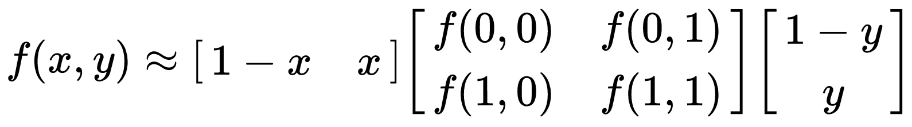
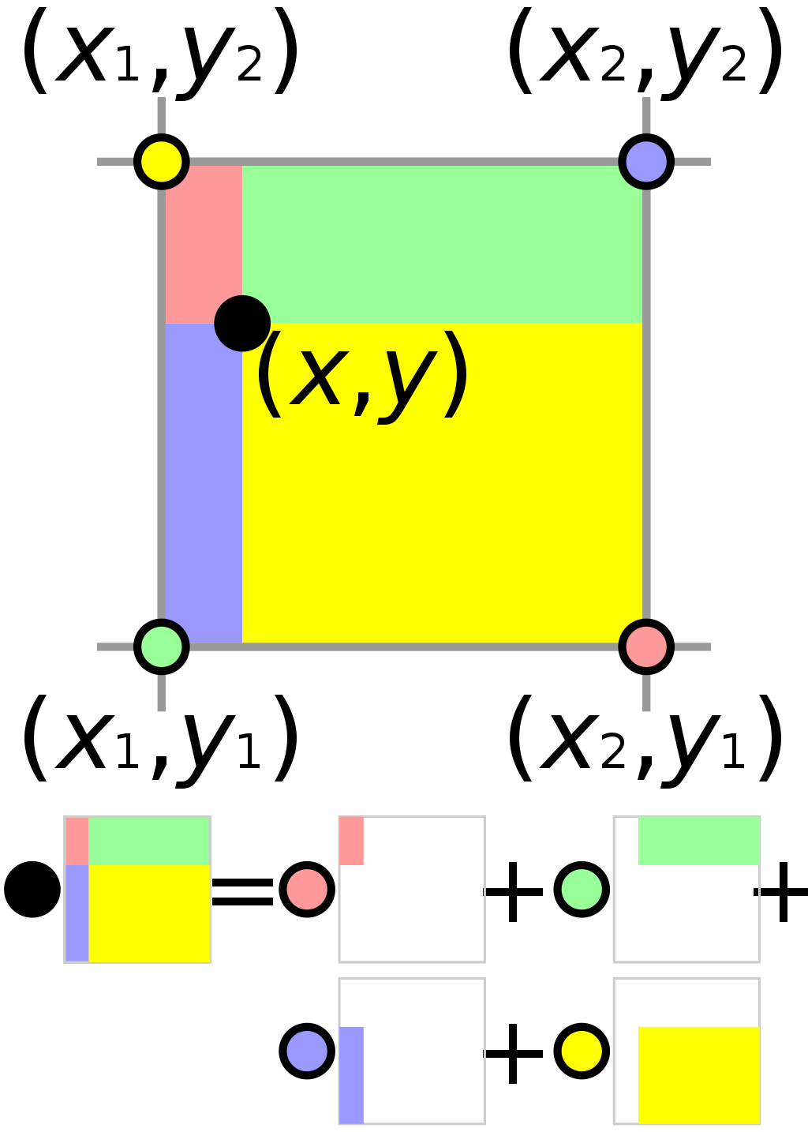
Bilinear Interpolation

Slide 9
Bilinear Interpolation

Slide 10
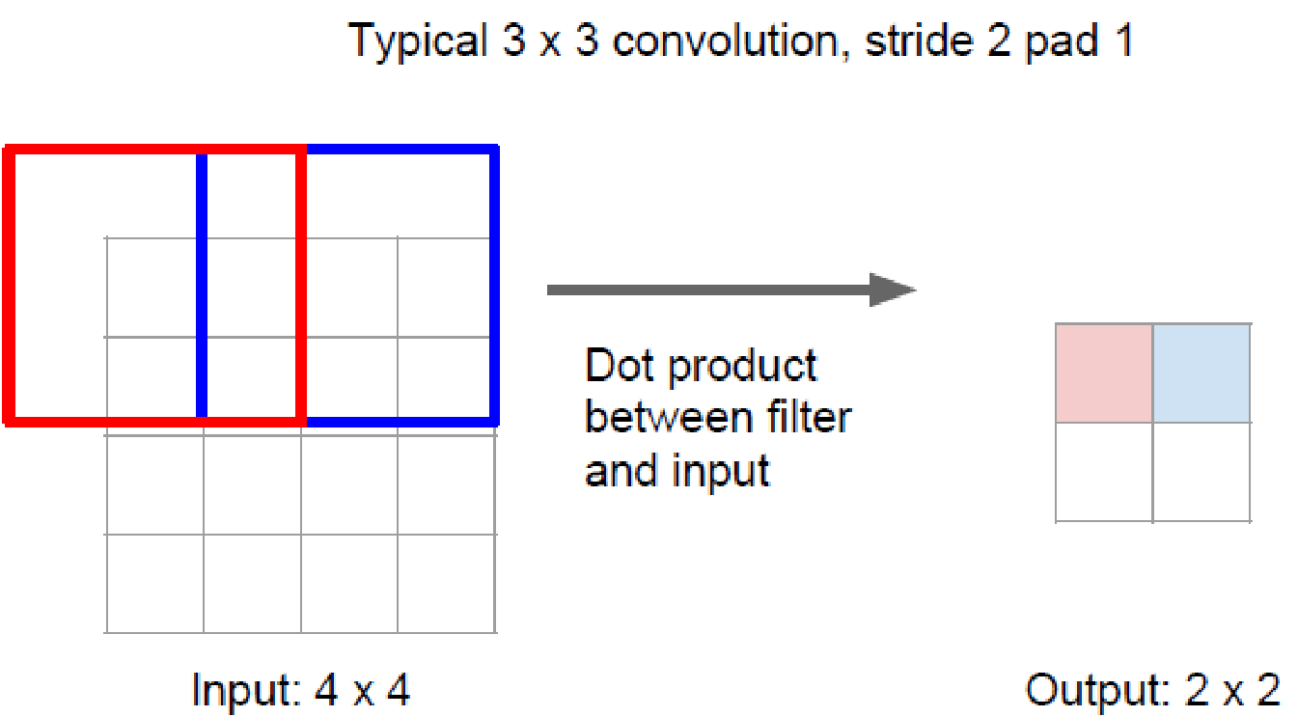
Convolution
1
3
2
1
2

Slide 11
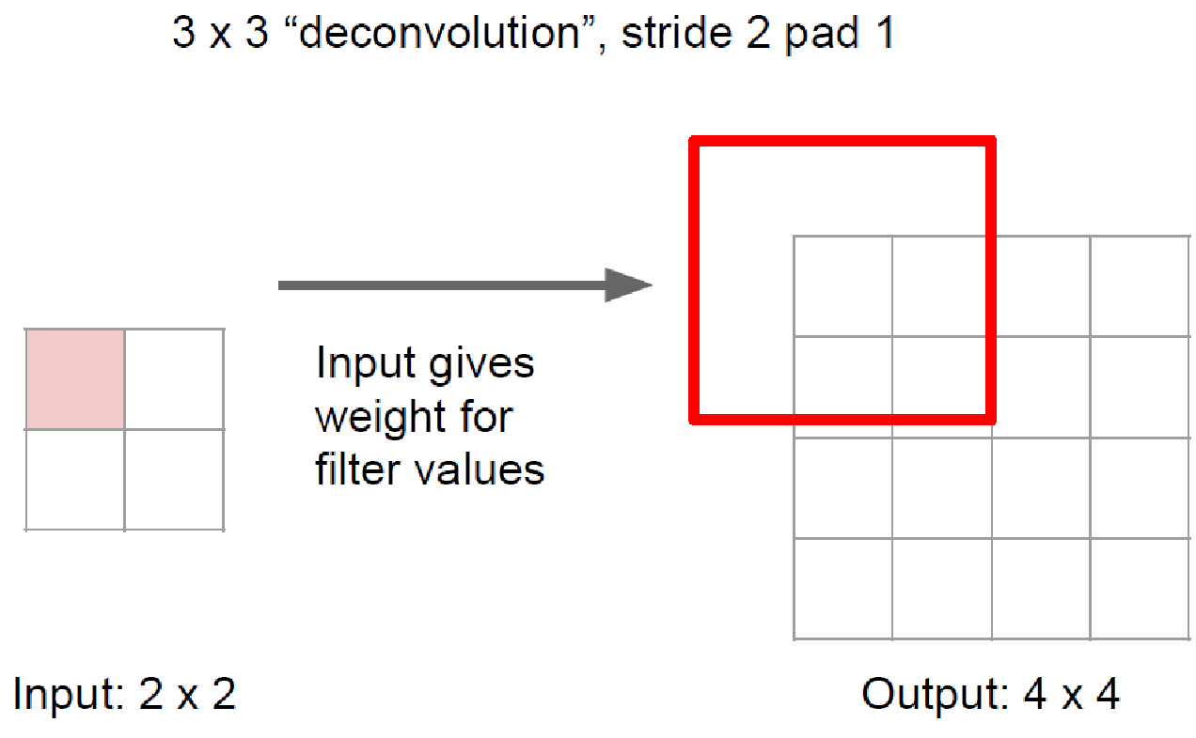
Deconvolution

Slide 12
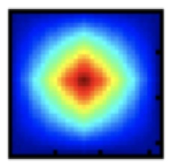

Bilinear Interpolation Filter
Bilinear interpolation filter
Same filter for every class
No filter learning!
How does the decoding work?
The decoding filter is fixed.
Fining-tuning convolutional layers of the network with segmentation ground-truth.
Fixed
Pretrained on ImageNet
Fine-tuned for segmentation
64x64 bilinear interpolation filter

Slide 13
Bilinear Interpolation Filter & Deconvolution

Slide 14
Exercise 1. Implement Bilinear Interpolation Filter
Implement x 32 Bilinear Interpolation Filter by deconvolution with kernel size = 64, stride = 32
A*f(0,0)
B*f(0,0)
A*f(0,0)
B*f(0,0)
C*f(0,0)
D*f(0,0)
C*f(0,0)
D*f(0,0)
+
A*f(1,1)
C*f(1,1)
C*f(1,1)
D*f(1,1)

Slide 15
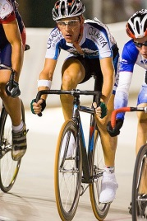
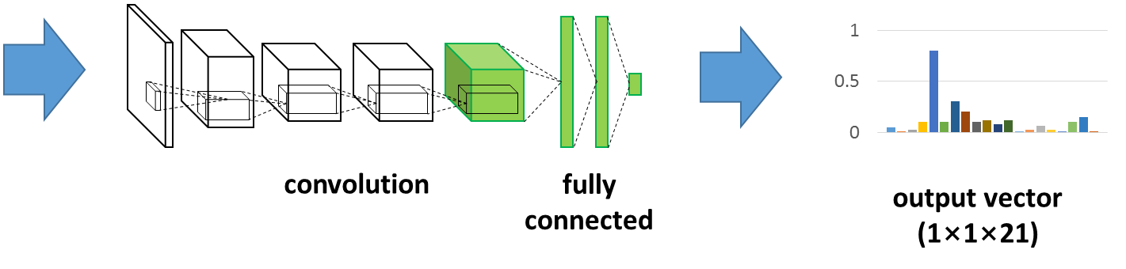
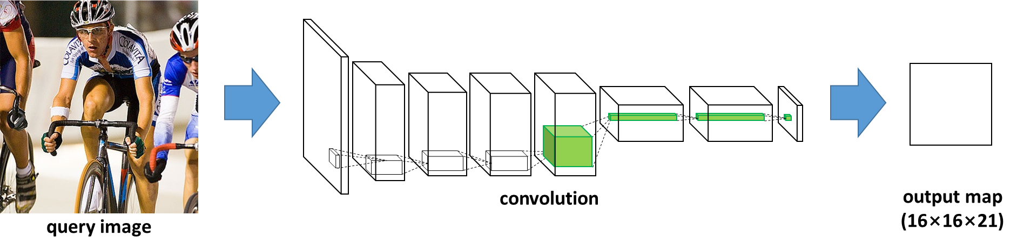
Semantic Segmentation using CNN
A network with fully-connected layer
A network with fully-convolutional layer
query image

Slide 16
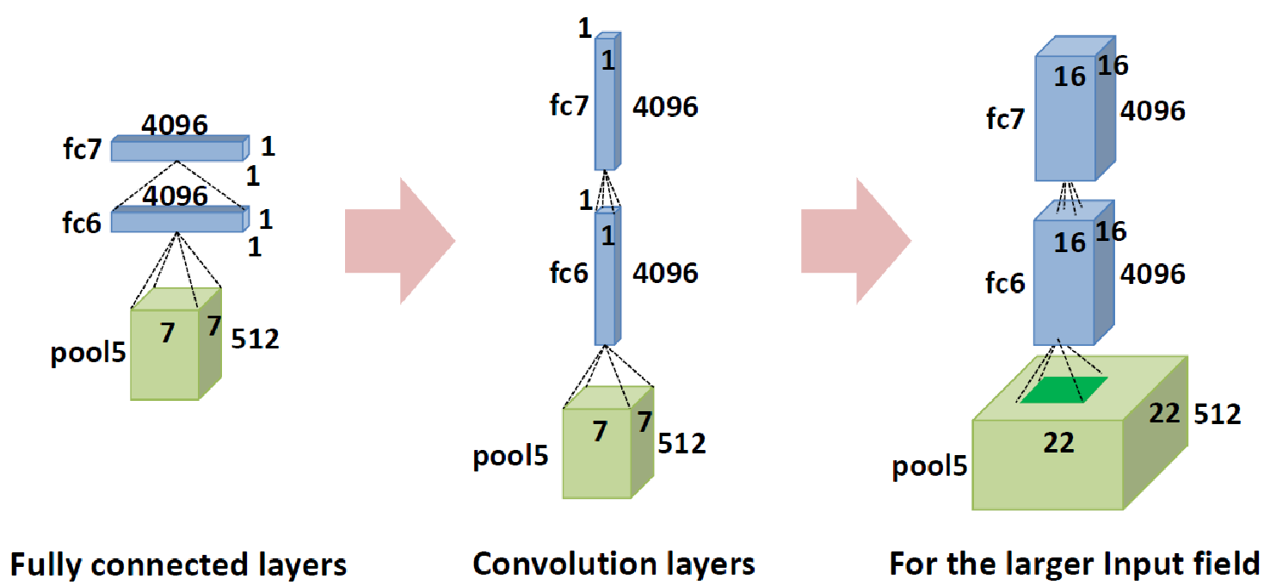
How to Apply Classification Network?
Exercise 2
Interpreting fully connected (fc) layers as convolution layers
Each fc layer is identical to a convolution layer with a large spatial filter that covers entire input field

Slide 17
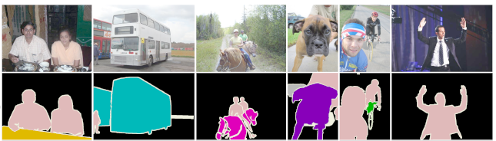
Semantic Segmentation Datasets
PASCAL VOC 2012
For image classification, object detection, image segmentation, action recognition
20 classes, 1464 training images and 1449 validation images
Typically using the augmented dataset with 8498 additional training images
Several extension to PASCAL-Parts, PASCAL-Context, PASCAL-Scribble
http://host.robots.ox.ac.uk/pascal/VOC/

Slide 18
Learning FCN
Dataset
PASCAL VOC 2012
Dataset
PASCAL VOC 2012
1-step (iteration) of Learning
Model
FCN
Get Batch data
(Real-world) problem
Recognize region of object
Learning
Adam
Forward/Backward
Model evaluation
Mean IU
Update
Model Parameter
Deployment
Model evaluation
Mean IU
Notes:
학습을 사용하여 어떤 알고리즘을 만들자고 하면 이러한 파이프라인을 따른다고 볼 수 있을 것 같습니다. 강의에서는 주로 Model & Learning 부분을 다룬다고 보시면 될 것 같습니다.
이 그림

Slide 19
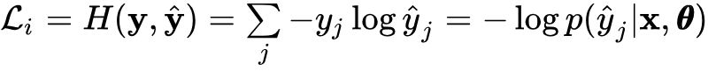
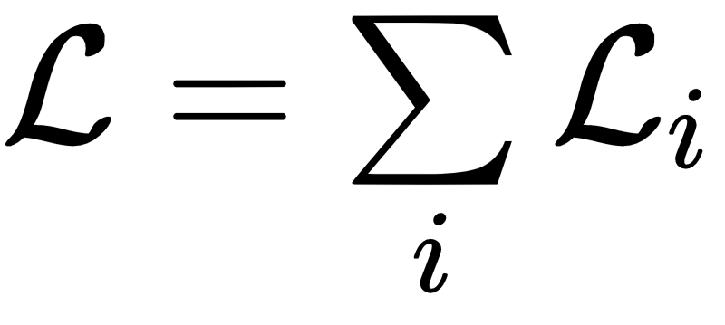
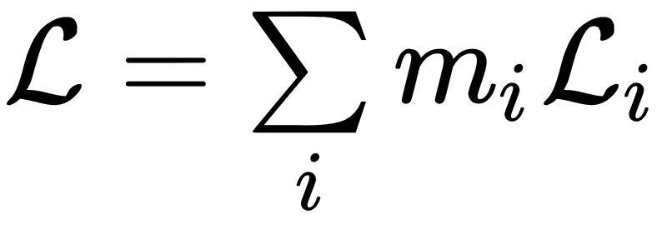
Loss
Pixel-wise classification loss
Cross-Entropy loss per pixel
Aggregation over all pixels in the output segmentation map
Pixel-wise classification loss with ignore label
Aggregation over all pixels in the output segmentation without ignored pixels

